Slide 1
Traffic Meter City Traffic Using D3 Charts
Traffic Charts for City of San Francisco
Shanthi Sivanesan

Slide 2
Technology
Web Application using
HTML5,
JQuery
Twitter Bootstrap
D3 Charts

Slide 3
Concept
Public can use this to decide transport means, Travel time
The charts can help city plan
Road block timings during road work and parade
Add officers on duty especially during any major events ,parades or sports events

Slide 4
Time Slicer
Time Slicer will drive the charts to pull data for a specific date range
Time Slicer can be zoomed/panned and the date range can be selected
Time slicer can drive the rest of the charts on the dashboard

Slide 5
Dash Board Charts
Horizontal bar Chart
Pulls the data by date range
Pie Chart
Shows the overall Traffic volume caused by types of vehicle
Line Chart
Daily
Hourly

Slide 6
Future Developments
Include Air traffic
Include traffic volume by street, so that fire engines can decide the best route to take
Get Live date using the City using API calls
Mobile App

Slide 7
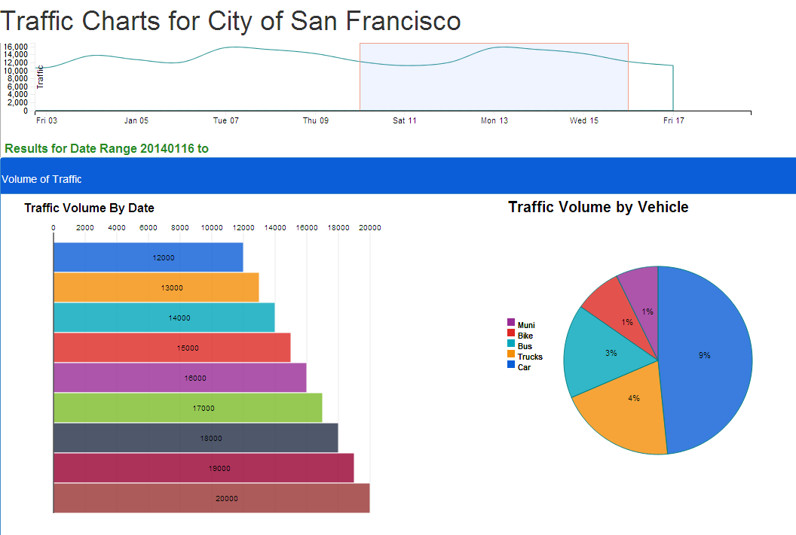
Demo

